Slide 1
Foundations of Cryptography private information retrieval
LiangFeng Zhang
zhanglf@shanghaitech.edu.cn
SIST, ShanghaiTech, 2019F

Slide 2
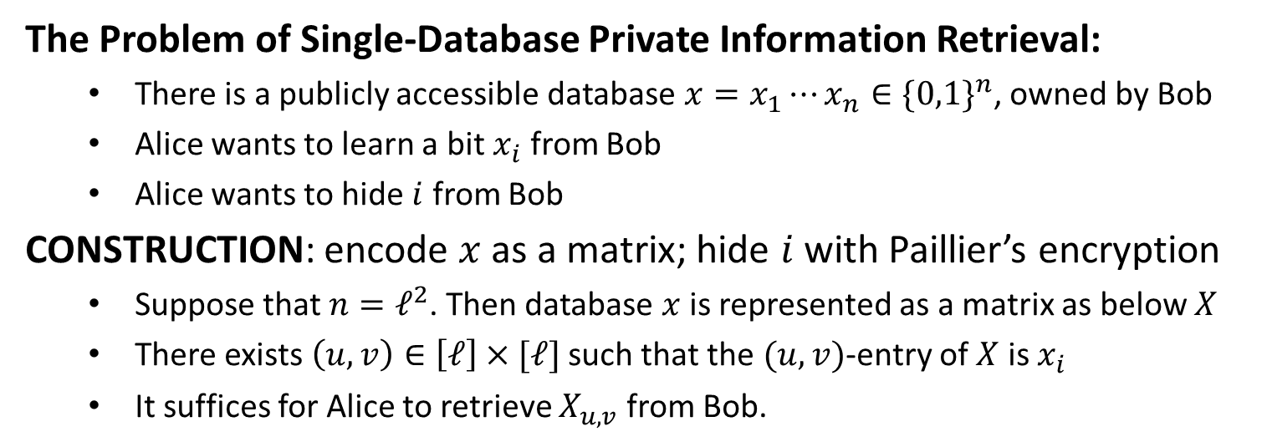
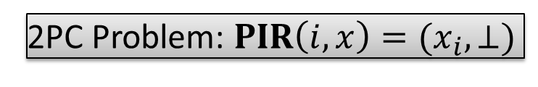

Private Information Retrieval
The Problem of Single-Database Private Information Retrieval:
There is a publicly accessible database ${x=x}_{1}⋯x_{n}∈{\{0,1\}}^{n}$, owned by Bob
Alice wants to learn a bit $x_{i}$ from Bob
Alice wants to hide $i$ from Bob
CONSTRUCTION: encode $x$ as a matrix; hide $i$ with Paillier’s encryption
Suppose that $n=ℓ^{2}$. Then database $x$ is represented as a matrix as below $X$
There exists $\left(u,v\right)∈\left[ℓ\right]×[ℓ]$ such that the $(u,v)$-entry of $X$ is $x_{i}$
It suffices for Alice to retrieve $X_{u,v}$ from Bob.
2PC Problem: $PIR\left(i,x\right)=(x_{i},⊥)$
$$x_{i}$$

Slide 3

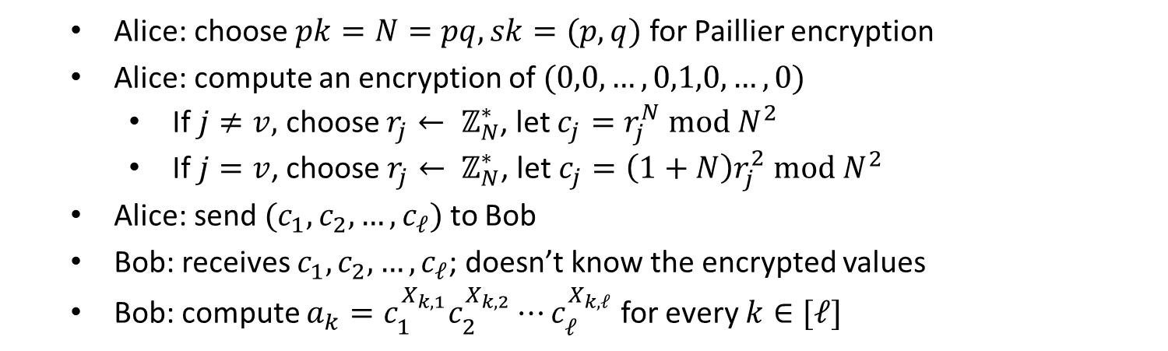







Construction
Alice: choose $pk=N=pq, sk=(p,q)$ for Paillier encryption
Alice: compute an encryption of $(0,0,…,0,1,0,…,0)$
If $j≠v,$ choose $r_{j}← ℤ_{N}^{∗}$, let $c_{j}=r_{j}^{N} mod N^{2}$
If $j=v$, choose $r_{j}← ℤ_{N}^{∗}$, let $c_{j}=\left(1+N\right)r_{j}^{2} mod N^{2}$
Alice: send $(c_{1},c_{2},…,c_{ℓ})$ to Bob
Bob: receives $c_{1},c_{2},…,c_{ℓ}$; doesn’t know the encrypted values
Bob: compute $a_{k}=c_{1}^{X_{k,1}}c_{2}^{X_{k,2}}⋯c_{ℓ}^{X_{k,ℓ}}$ for every $k∈[ℓ]$
$$a_{1}$$
$$a_{2}$$
$$a_{u}$$
$$a_{ℓ}$$
$$c_{1}$$
$$c_{2}$$
$$c_{v}$$
$$c_{ℓ}$$

Slide 4

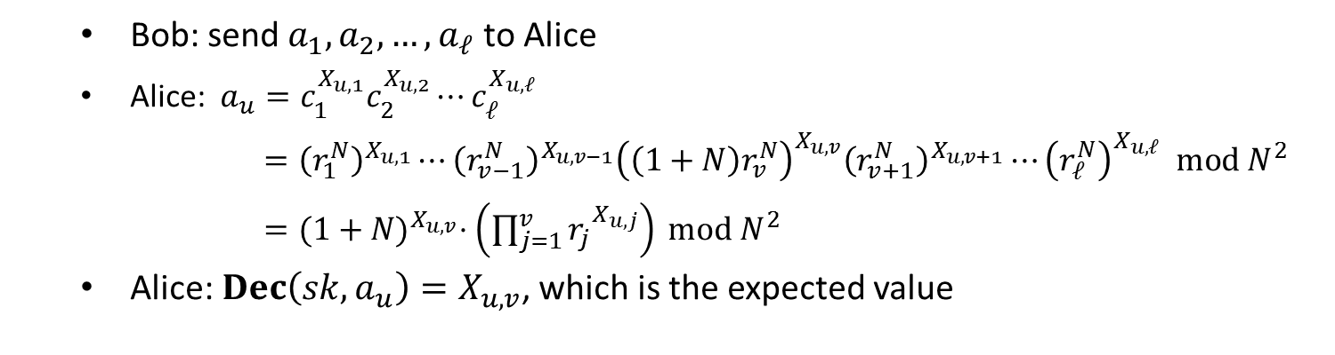







Construction
Bob: send $a_{1}, a_{2},…,a_{ℓ}$ to Alice
Alice: $a_{u}=c_{1}^{X_{u,1}}c_{2}^{X_{u,2}}⋯c_{ℓ}^{X_{u,ℓ}}$
$={\left(r_{1}^{N}\right)}^{X_{u,1}}⋯{\left(r_{v−1}^{N}\right)}^{X_{u,v−1}}{\left(\left(1+N\right)r_{v}^{N}\right)}^{X_{u,v}}{\left(r_{v+1}^{N}\right)}^{X_{u,v+1}}⋯{\left(r_{ℓ}^{N}\right)}^{X_{u,ℓ}} mod N^{2}$
$={(1+N)}^{X_{u,v}}⋅\left({\prod_{j=1}^{v}{r_{j}}}^{X_{u,j}}\right) mod N^{2}$
Alice: $Dec\left(sk, a_{u}\right)=X_{u,v}$, which is the expected value
$$a_{1}$$
$$a_{2}$$
$$a_{u}$$
$$a_{ℓ}$$
$$c_{1}$$
$$c_{2}$$
$$c_{v}$$
$$c_{ℓ}$$

Slide 5
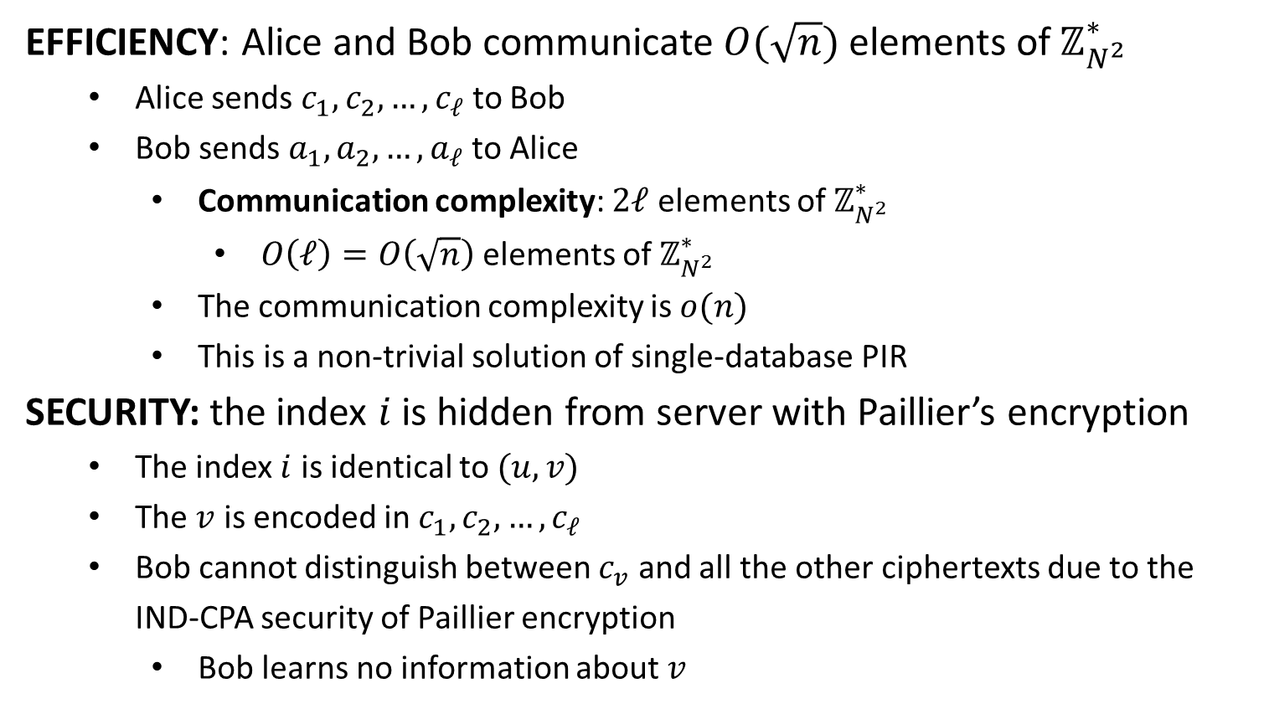
Evaluation
EFFICIENCY: Alice and Bob communicate $O(\sqrt{n})$ elements of $ℤ_{N^{2}}^{∗}$
Alice sends $c_{1},c_{2},…,c_{ℓ}$ to Bob
Bob sends $a_{1},a_{2},…,a_{ℓ}$ to Alice
Communication complexity: $2ℓ$ elements of $ℤ_{N^{2}}^{∗}$
$O\left(ℓ\right)=O\left(\sqrt{n}\right)$ elements of $ℤ_{N^{2}}^{∗}$
The communication complexity is $o(n)$
This is a non-trivial solution of single-database PIR
SECURITY: the index $i$ is hidden from server with Paillier’s encryption
The index $i$ is identical to $(u,v)$
The $v$ is encoded in $c_{1},c_{2},…,c_{ℓ}$
Bob cannot distinguish between $c_{v}$ and all the other ciphertexts due to the IND-CPA security of Paillier encryption
Bob learns no information about $v$

